Slide 1

Circles
RCET 0264 Introductory Calculus
Tim Leishman

Slide 2
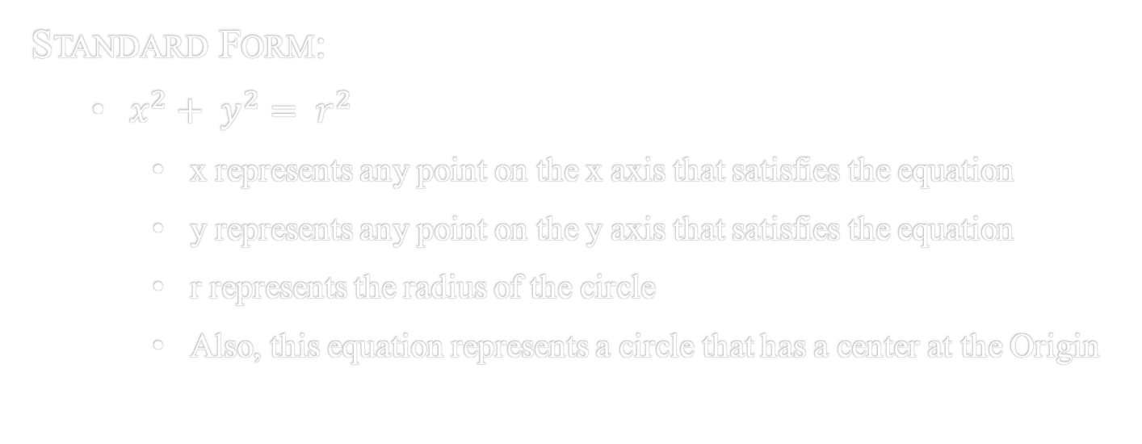
Circles
Standard Form:
$x^{2}+ y^{2}= r^{2}$
x represents any point on the x axis that satisfies the equation
y represents any point on the y axis that satisfies the equation
r represents the radius of the circle
Also, this equation represents a circle that has a center at the Origin

Slide 3
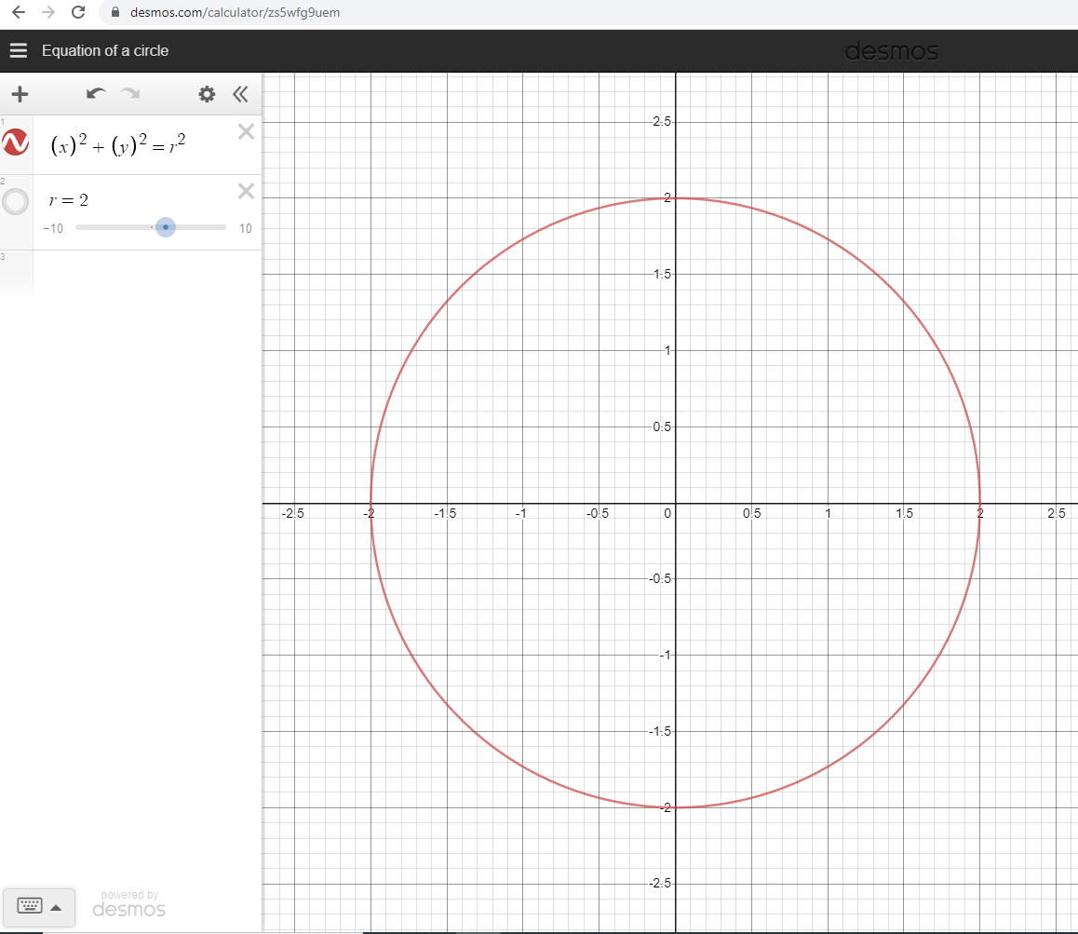
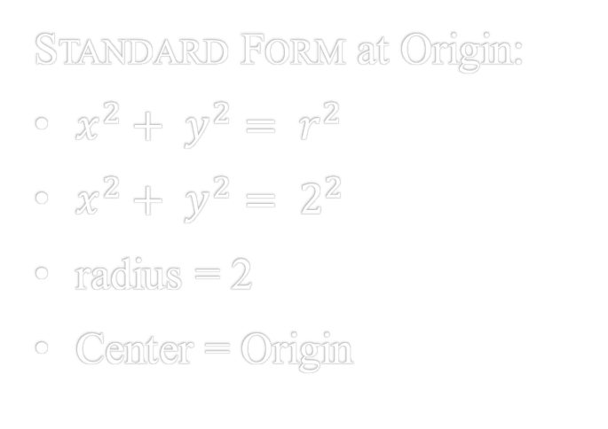
Circles
Standard Form at Origin:
$x^{2}+ y^{2}= r^{2}$
$x^{2}+ y^{2}= 2^{2}$
radius = 2
Center = Origin

Slide 4
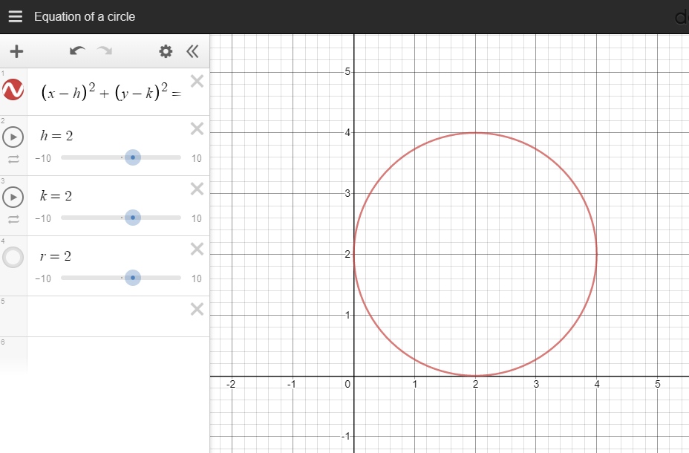
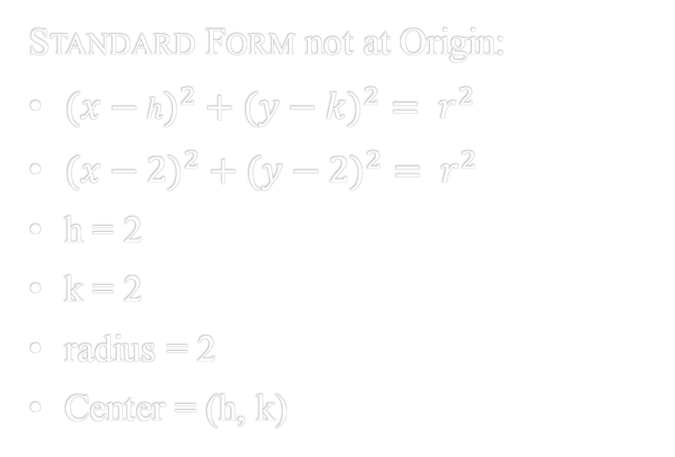
Circles
Standard Form not at Origin:
$({x−h)}^{2}+({y−k)}^{2}= r^{2}$
$({x−2)}^{2}+({y−2)}^{2}= r^{2}$
h = 2
k = 2
radius = 2
Center = (h, k)

Slide 5
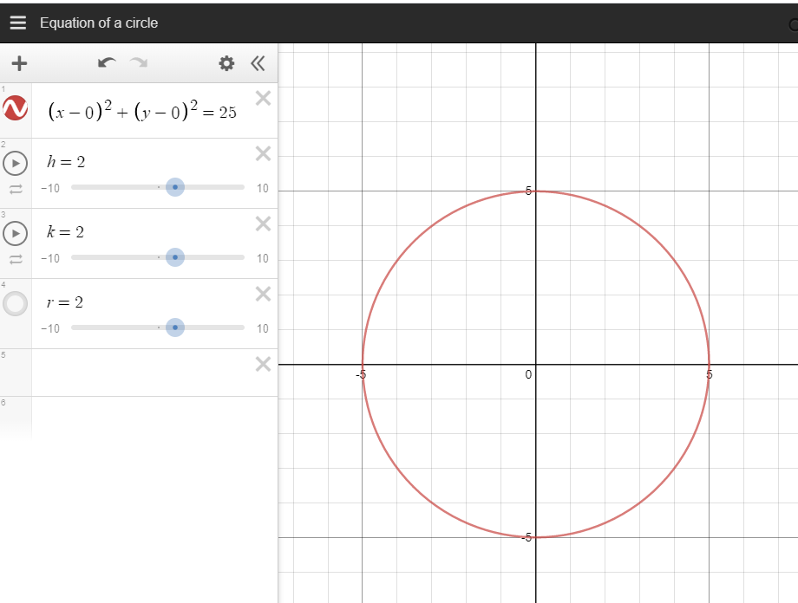

Circles
Example 1:
$x^{2}+ y^{2}=25$
$r^{2}=25$
$r= \sqrt{25}$
$r=5$
Technically, h & k = 0
Center = (0, 0)

Slide 6
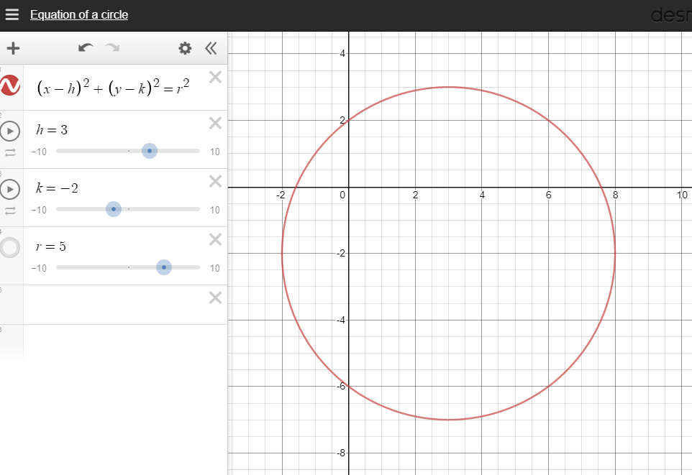

Circles
Example 2:
$\text{Center}\text{ = (3, −2)}$
Points = (-1, 1)
$({x−h)}^{2}+({y−k)}^{2}= r^{2}$
$({−1−3)}^{2}+({1−−2)}^{2}= r^{2}$
$({−4)}^{2}+({3)}^{2}= r^{2}$
$16+9= r^{2}$
$r^{2}=25$
$r=5$
Final Equation:
$({x−3)}^{2}+({y+2)}^{2}=25$

Slide 7
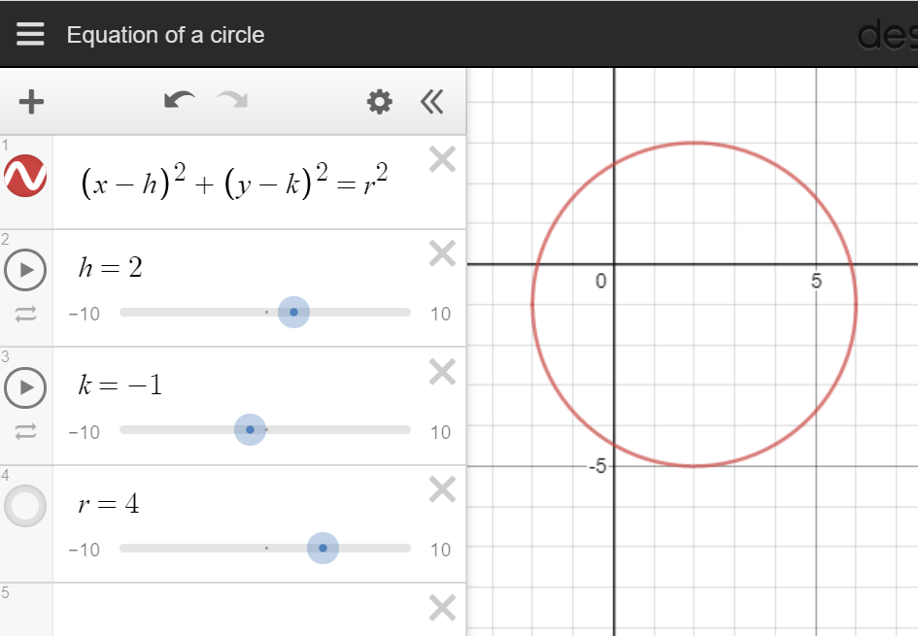
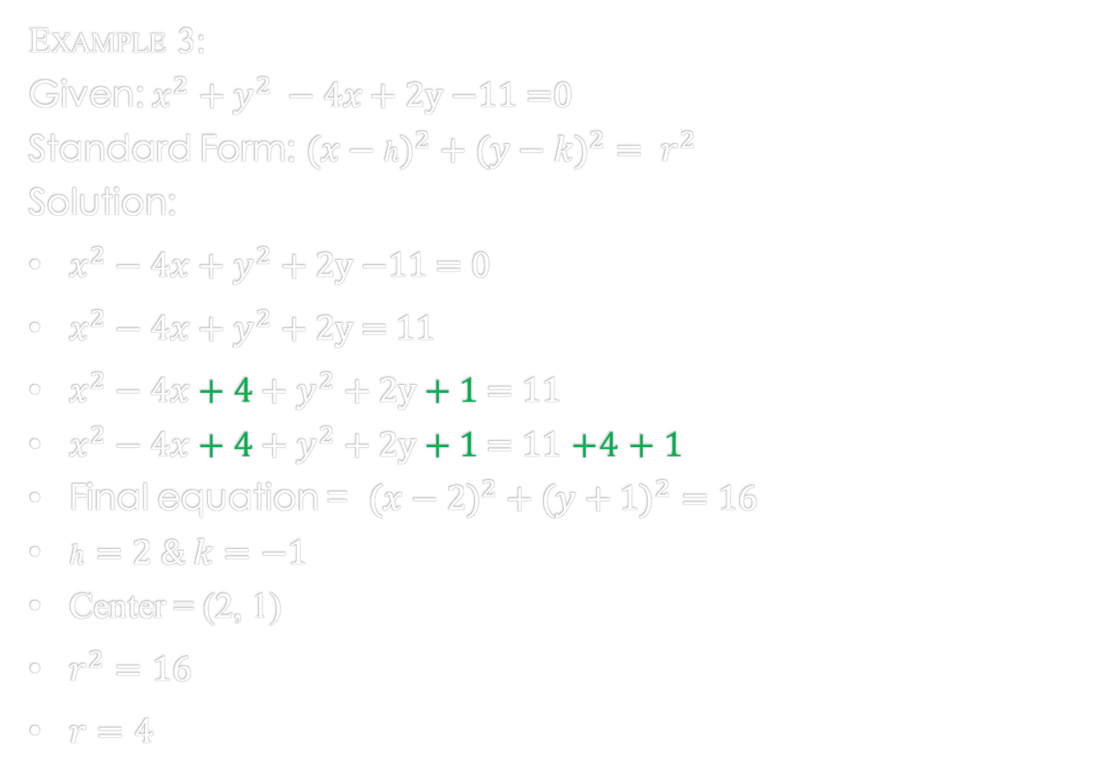
Circles
Example 3:
Given: $x^{2}+y^{2} −4x\text{ + 2}\text{y}\text{ −11 =0}$
Standard Form: $({x−h)}^{2}+({y−k)}^{2}= r^{2}$
Solution:
$x^{2}−4x+y^{2}\text{ + 2}\text{y}\text{ −11 = 0}$
$x^{2}−4x+y^{2}\text{ + 2}\text{y}\text{ = 11}$
$x^{2}−4x+4+y^{2}\text{ + 2}\text{y} \text{+ 1} \text{=} \text{11}$
$x^{2}−4x+4+y^{2}\text{ + 2}\text{y}\text{ + 1 = 11}$ $+4$ $\text{+ 1 }$
Final equation = $({x−2)}^{2}+({y+1)}^{2}=16$
$h=2 \& k=−1$
Center = (2, 1)
$r^{2}=16$
$r=4$

Slide 8
Circles
References:
Ewen, D., Gary, J. S., & Trefzger, J. E. (2005). Technical calculus. Upper Saddle River, NJ: Pearson/Prentice Hall.
https://www.desmos.com/calculator/zs5wfg9uem

